Slide 1
Trunk Based Development
Viquar Mohammed Khan
+1 224-436-0783

Slide 2
Version Control Goal
Fail fast
Code conflicts and integration problems should be discovered as soon as possible.
Better to fix small problems often than to fix large problems seldom.
Always releasable
Even after a really bad sprint there should be at least something that is releasable.
Simple
All team members will be using this scheme every day, so the rules and routines must be clear and simple.

Slide 3
Version control strategy
Iteration Branching
Feature Branching
Trunk Based Development

Slide 4
Iteration Branching
Trunk - All clean and production code on trunk.
Feature Branch - Branches off trunk will be created on a per release basis for development of large features which could potentially be breaking if done on trunk
QA Release Branches - At the end of production release branch merge to trunk

Slide 5
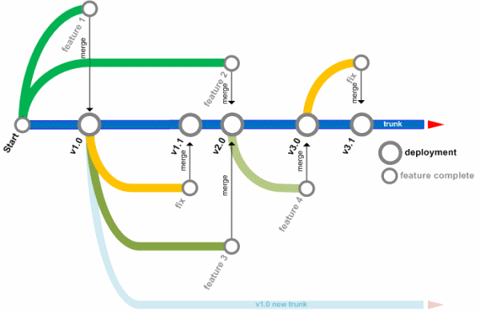
Feature Branching :
Create Branch for new feature from trunk
Developers commit their changes to a branch of a source code repository before merging to trunk at a later date.
The central branch known as trunk is considered a flawless representation of all previously released work.
New features for a particular release are developed on a long-lived branch
Developers commit changes to their branch, automated tests are executed, and testers manually verify the new features.
Features are then released into production from the branch merged into trunk by the developers
Regression tested on trunk . The branch can then be earmarked for deletion and should only be used for production defect fixes.

Slide 6
Trunk Based Development
Trunk Based Development new features are developed concurrently on trunk.
Development in trunk as series of small ,incremental steps .
Features are always released from trunk
Defect fixes are either released from trunk or a short-lived release branch most of time Fix on trunk
Build eng cherry-pick to the release branch .
Feature Toggle, which means a configuration parameter or business rule is used to turn a feature on or off at runtime
-Feature Toggle is turned off while its feature is in development (v1)
-Feature Toggle is turned on when its feature is in production (v2)
-Feature Toggle is removed after a period of time (v3).
No code freeze only Just before a release, a branch is cut for that release.
Release engineer change permissions for that branch so that the larger group of developers cannot commit to it even if they can see the branch.

Slide 7
Branch vs Trunk use case

Slide 8
Problem Feature Branching
Regressions testing required
Dangers in Multiple branch parallel development
Semantic conflict
Difficult to merge

Slide 9
TBD Prerequisite
Peer code review tool :Crucible ,code collaborator
Static code review tools : sonar
Test coverage tools EclEcmma
Continuous integration: Jenkins ,Maven
Regression test suite: BDD ,Selenium etc.

Slide 10
TBD Best practices :
Every feature has to have a toggle or switch. Before a feature is developed, the switch is developed for it. The toggles are at feature levels and not project level (remember toggles have to be in the code and not in configuration – we don’t want snowflakes in production)
Teams have to commit their code into trunk end the day – every day without fail
Unit tests should be developed before or at least at the same time as the feature is developed. Developers have to ensure the unit tests have passed before they attempt checking in
Tests have to be fired with every commit to ensure the sanity of the system, and not just the feature. Commit is allowed only if the tests succeed. This means basic set of acceptance tests which can execute within 5 minutes are developed
Code analysis is done with every commit to identify cyclomatic complexity, afferent and efferent coupling, code style etc
And of course the code is compiled and binaries prepared only if all the above are green and stored in the binary repository (artifactory for eg.)
Developer should rollback the changes if any of the quality parameters are not met or system is not working as expected. The developer moves to the next task only after commit is successfully completed or rollback

Slide 11

Companies are using TBD

Slide 12
More Continuous Delivery Resources:
Google’s Scaled Trunk Based Development – DZone Performance
Trunk Based Development Discussion
Feature Branches with Bamboo
Getting Started:
Trunk Based Development Branching
Feature Flag Driven Development – Trunk Based
Software Tools for Implementing Trunk Based Development
GitHub
Version control and branching
BitBucket
Version control and branching
LaunchDarkly
Feature flag management / production testing
CircleCI
Automated build and deploy to production

Slide 13
References
http://martinfowler.com/bliki/FeatureBranch.html
http://www.alwaysagileconsulting.com/articles/organisation-pattern-trunk-based-development/
https://www.infoq.com/articles/agile-version-control
Google's Scaled Trunk Based Development - DZone Performance
Trunk Based Development Discussion
Feature Branches with Bamboo
http://www.draconianoverlord.com/2013/09/07/no-cherry-picking.html

